Slide 1
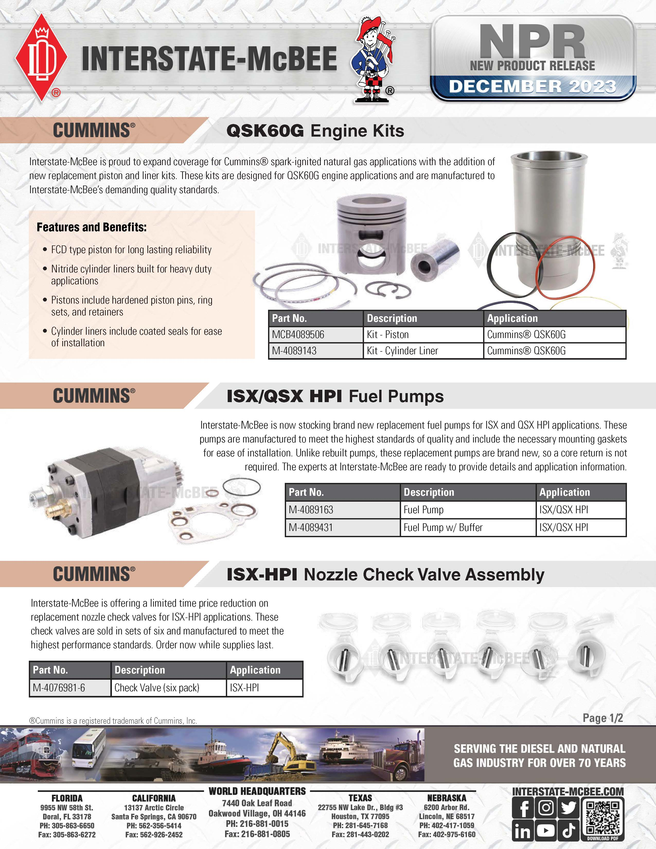

Distributor Name / 00000 Street Name / City Name, State 00000
000-000-0000 / www.companywebsite.com

Slide 2
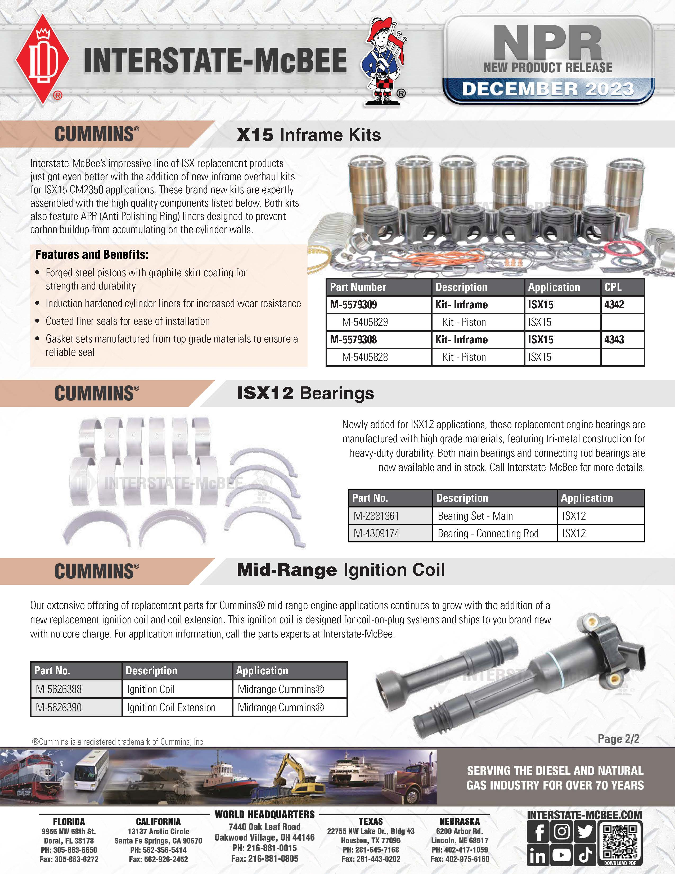
Distributor Name / 00000 Street Name / City Name, State 00000
000-000-0000 / www.companywebsite.com

