Slide 1


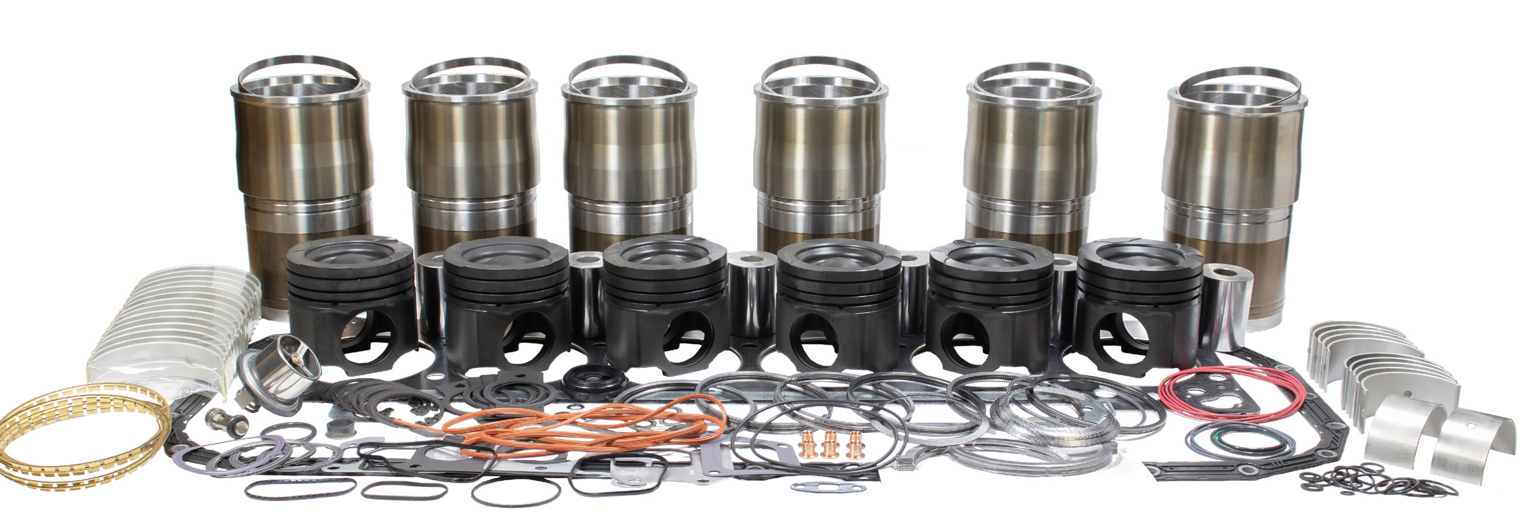







IN STOCK
July 2026
cum-flyer-x15kit
M-5579309
APR (ANTI-POLISHING RING)
FORGED STEEL FRICTION WELDED
PISTONS
INDUCTION HARDENED
CYLINDER LINERS
TRI-METAL
BEARINGS
HARDENED AND
TEMPERED PISTON PINS
COATED
LINER SEALS
NEW
THERMOSTAT
OVERHAUL GASKET SETS
ALSO INCLUDED:
High temp turbo mounting studs & nuts
New piston cooling nozzles
RING SETS
RETAINERS
X15 INFRAME KITS AVAILABLE NEAR YOU
Interstate-McBee’s inframe overhaul kits for Cummins® X15 applications are now in stock across all of our branches. Order online at orders.interstate-mcbee.com or call 1 (800) 321-4234.
PART NUMBER | DESCRIPTION | APPLICATION | CPL
M-5579309 | Inframe Kit | X15 EPA 2017 (CM2350) - 150mm | 4342
M-5579308 | Inframe Kit | X15 EPA 2017 (CM2350) - 150mm | 4343
®Cummins is a registered trademark of Cummins, Inc. All names, numbers, symbols, and descriptions are
registered trademarks of Cummins, Inc. and do not imply that the item/s are a product of said manufacturer.
Serving the Diesel and Natural Gas Industry for Over 75 Years
INTERSATE-McBEE.com
Distributor Name / 00000 Street Name / City Name, State 00000
000-000-0000 / www.companywebsite.com
WORLD HEADQUARTERS FLORIDA CALIFORNIA TEXAS NEBRASKA
DOWNLOAD
7440 Oak Leaf Rd
Oakwood Village, OH 44146
P: (216) 881–0015
F: (216) 881–0805
9955 NW 58th St
Doral, FL 33178
P: (305) 863–6650
F: (305) 863–6272
13137 Arctic Cir
Santa Fe Springs, CA 90670
P: (562) 356–5414
F: (562) 926–2452
22755 NW Lake Dr, Bldg #3
Houston, TX 77095
P: (281) 645–7168
F: (281) 443–0202
6200 Arbor Rd
Lincoln, NE 68517
P: (402) 417–1059
F: (402) 975–6169

