Slide 1


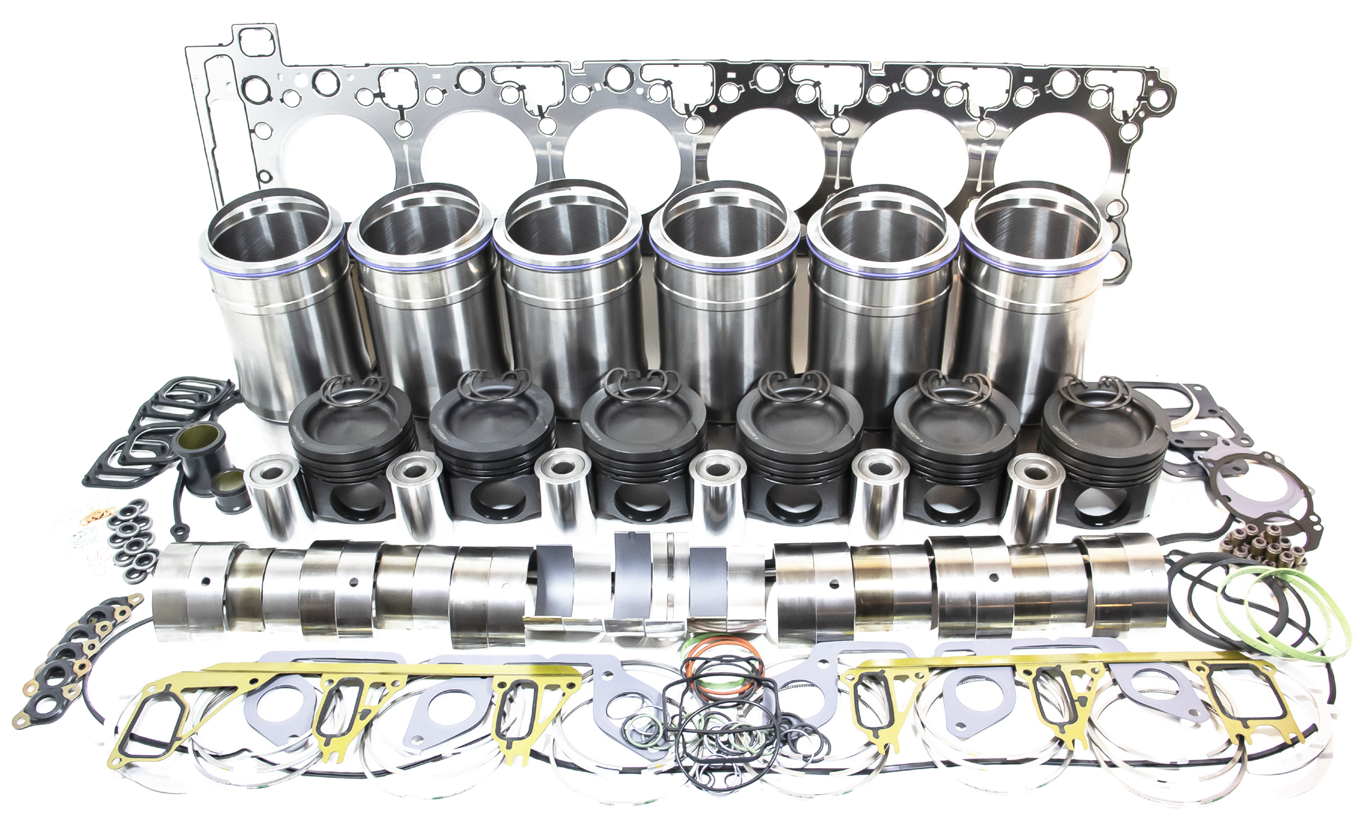
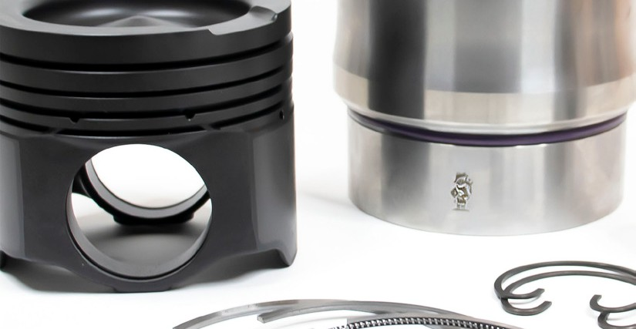
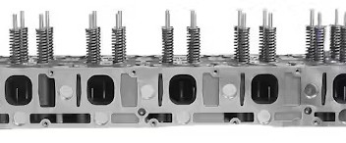
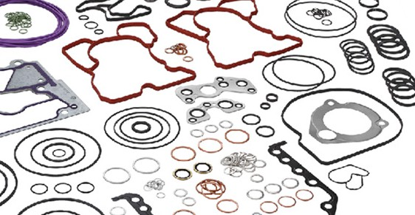
DETROIT DIESEL DD15
Replacement Parts for
®
Applications
ENGINE KITS | COMPONENTS | GASKET SETS
®Detroit Diesel is a registered trademark of Detroit Diesel, Inc. April 2026

Slide 2
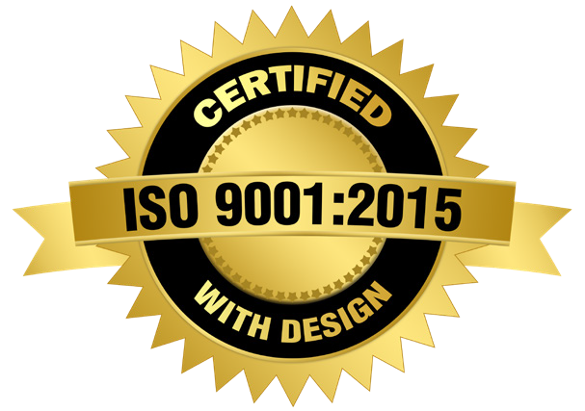
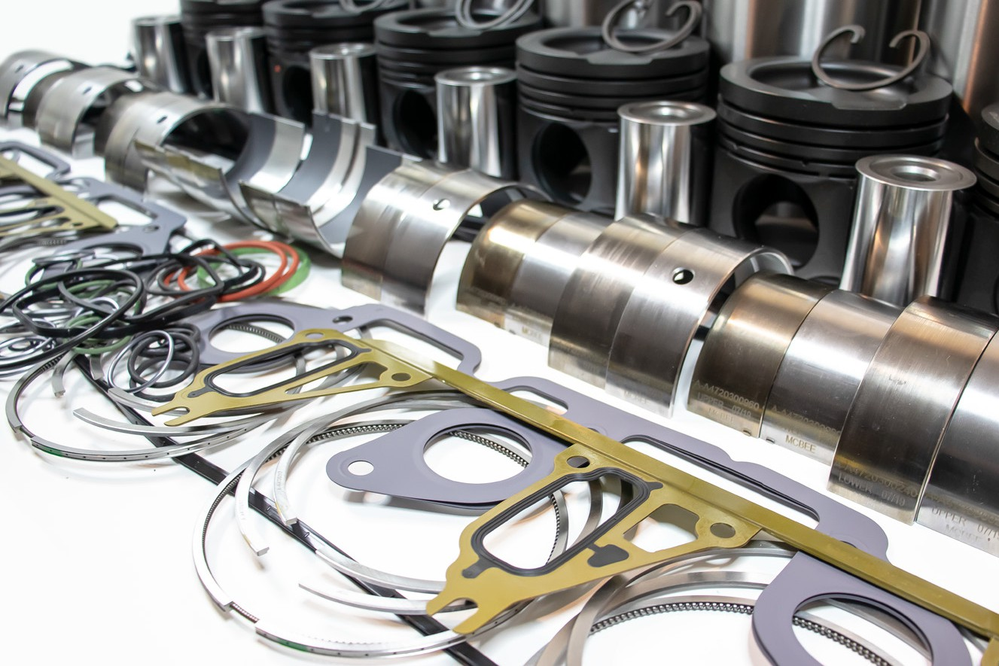
ENGINE KITS
Interstate-McBee’s offering for popular DD15 engine applications continues to grow as we add high quality replacement parts to our lineup regularly. Our range of products covers engine kits, fuel injection, gaskets and more. These parts go through an extensive qualification process and are covered by our industry-leading warranty. Interstate-McBee is proud to be ISO 9001:2015 Certified with Design.
Inframe Kit Includes: Pistons - O-rings Ring Sets - Rod Bearings Piston Pins - Main Bearings Retainers - Inframe Gasket Kit Liners - Rod & Main Bolts (Re-ring kit same as above, but no pistons). |  | Model
 |  | EPA 07 | EPA 10 | GHG 14 | GHG 17 | EPA 07 Export
 |  | 472900 472901 472902 | 472903 472904 472905 | 472906 472909 | 472910 | 472907 472908
Description | QTY | Part Number
Re Ring Kit - Composite Oil Pan | 1 | MCIFDD15-012 | MCIFDD15-022 | MCIFDD15-032 | MCIFDD15-032 | MCIFDD15-032
Inframe Kit - Composite Oil Pan | 1 | A-MCIF2317-012 | A-MCIF2317-022 | A-MCIF2317-032 | A-MCIF2817-032 | A-MCIF2317-032
Inframe Kit - Aluminum Oil Pan | 1 | A-MCIF2317-062 | A-MCIF2317-052 | A-MCIF2317-042 | A-MCIF2817-042 | A-MCIF2317-042
Piston Kit - Friction Welded | 6 | A-A4720302317 | A-A4720302317 | A-A4720302317 | A-A4720302817 | A-A4720302317
Ring Set | 6 | A-A4720300424 | A-A4720300424
Ring Set - Friction Welded Piston | 6 | A-A4720300624 | A-A4720300624 | A-A4720300624 | A-A4720300624 | A-A4720300624
Liner Kit - Non-APR | 6 | A-A4720111810 | A4720111810
Liner Kit - APR | 6 |  |  | A-A4720111910 | A-A4720111910 | A-A4720111910
Features and Benefits:
Forged steel one-piece pistons with skirt coating for reduced friction
Interstate-McBee cylinder liners with superior bore finish
New connecting rod bolts
Kits can be ordered with APR
(Anti Polishing Ring) or non-APR style liners
Kits can be customized with piston rings for Monotherm style pistons (4mm oil ring) or later style pistons
Inframe and re-ring kits include high performance rod and main bearings

Slide 3
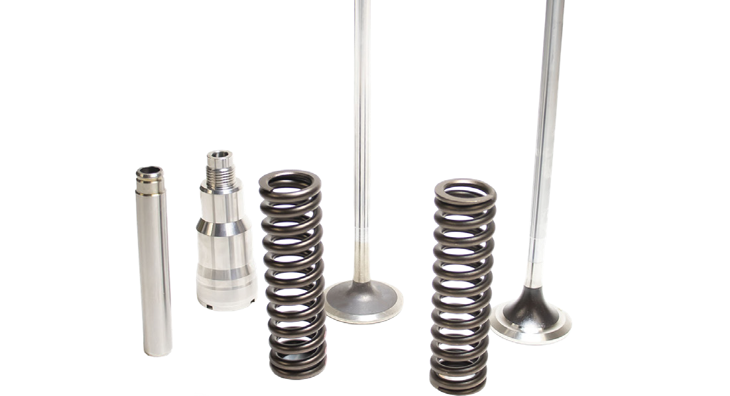
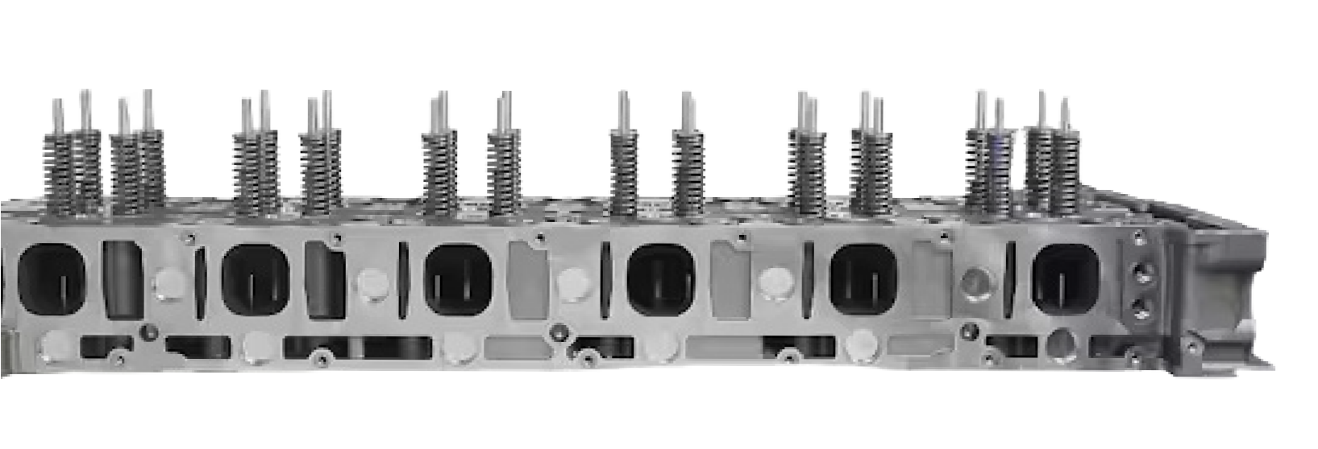

ENGINE PARTS
Description | QTY | Part Number |  | Description | QTY | Part Number
Bearing - Con Rod | 6 | A-A4720300960 |  | Valve – Intake | 12 | A-A4730500126
Main Bearing | 7 | A-A4720300240 |  | Valve – Exhaust | 12 | A-A4730500127
Thrust Washer Set | 1 | A-A4720300445 |  | Guide – Valve | 12 | A-A4720531130
Retainer - Piston Pin | 12 | A-A4729940241 |  | Seal – Valve Stem | 24 | A-A4700530158
Connecting Rod Bushing | 6 | MCB7150 |  | Lock – Valve | 48 | A-A4720530026
Bolt - Cooling Nozzle | 6 | A-N000000004795 |  | Injector Tube | 6 | A-A4720780273
Nozzle - Piston Cooling | 6 | A-A4721800043 |  | Seal Ring - Injector Tube | 6 | A-A0249976445
Bolt - Connecting Rod | 12 | A-A4720380071 |  | Spring – Intake Valve | 12 | A-A4720530420
Oil Pan Seal Composite pan | 1 | A-A4720140322 |  | Spring – Exhaust Valve | 12 | A-A4720530520
Oil Pan Gasket Aluminum Pan | 1 | A-A4720140022 |  | Injector Installation Kit | 6 | A-A4600700887
Collar Screw Pan | 18 | A-A4720140583
Front Oil Seal | 1 | A-A0169970646
Rear Oil Seal | 1 | A-A0159974946
Gear Drive Seal | 1 | A-A4729970845
Oil Cooler | 1 | A-A4721800965
Water Pump (pump only) | 1 | A-A4722000401
Water Pump (Variable Speed) | 1 | A-A4712000901
Head Bolt | 38 | A-A4720160169
CYLINDER HEADS
Interstate-McBee has also recently added a new line of replacement cylinder heads for Detroit Diesel® DD15 applications. These precision machined heads arrive loaded with new intake and exhaust valves, valve springs, valve guides, and injector tubes. Use the QR code below to access the full flyer for full part number listing, shipping information, and more. Supply is limited so order in advance.
Brand New Castings
No Core Return Required
One Year Warranty

Slide 4
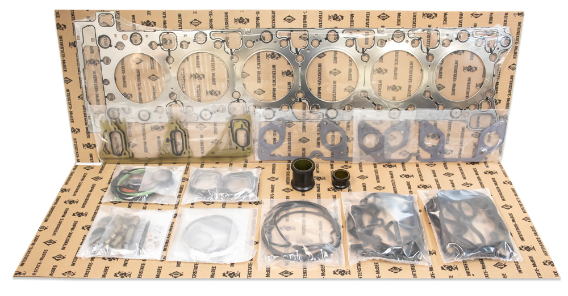
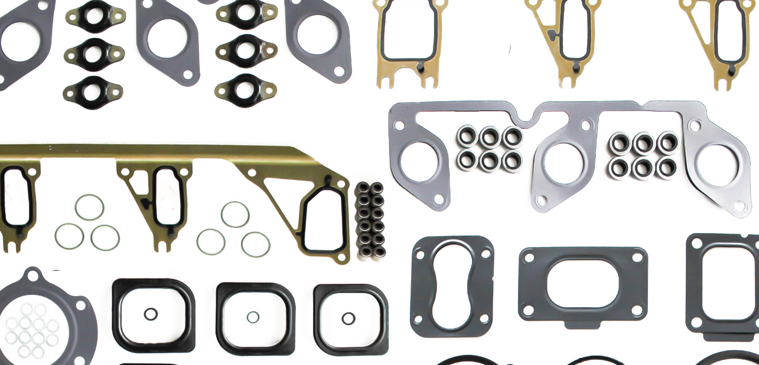



GASKETS
Interstate-McBee is your source for custom gasket sets that contain the necessary parts to install the cylinder heads, perform inframe overhauls, and more. Our gasket set components are manufactured from top grade materials and molded for an exact fit. Our head gaskets are constructed from multi-layer steel for superior sealing and durability. Check out our
complete line of gaskets and sets below.
 |  | Model
 |  | 2007-2009 | 2010-2012 | 2013 & 2016
 |  | EPA07: 472900 472901 472902 | EPA10: 472903 472904 472905 | EPA10: 472906 472907 472908 402909 | GHG 17: 472910
Description | QTY | Part Number
Gasket Set - Inframe - Composite Pan | 1 | MCBD150012 | MCBD150022 | MCBD150032
Gasket Set - Inframe - Aluminum Pan | 1 | MCBD150062 | MCBD150052 | MCBD150042
Head Gasket Set - McBee Style | 1 | MCBD150013 | MCBD150023 | MCBD150033
Head Gasket Set - OEM Style | 1 | A-A4710161520 | A-A4720161920 | A-A4720162120
Gasket - Rocker Cover | 1 | A-A4720160180 | A-A4720160121 | A-A4720160121
Gasket - Oil Pan | 1 | A-A4720140322 | A-A4720140322 | A-A4720140322
Seal - Oil Pickup Tube | 1 | A-A4721870980 | A-A4721870980 | A-A4721870980
Seal - Oil Pickup Tube | 1 | A-A4721870880 | A-A4721870880 | A-A4721870880
Gasket kit-Oil pump/Pickup | 1 | MCBDD13006 | MCBDD13006 | MCBDD13006
Gasket - Cam Cover Seal | 1 | A-A4720160680 | A-A4720160680 | A-A4720160680
Gasket Set - Lower | 1 | A-A4720102205 | A-A4720102205 | A-A4720102205
Seal - Crankshaft - Front | 1 | A-A0169970646 | A-A0169970646 | A-A0169970646
Seal - Crankshaft - Rear | 1 | A-A0159974946 | A-A0159974946 | A-A0159974946
Interstate-McBee Custom Gasket Sets for
DD15 Applications Include the Following:
Cylinder head installation gaskets
Exhaust manifold gaskets
Intake manifold gaskets
Water manifold gaskets
Gaskets and seals to mount EGR
Rocker cover gaskets
Oil pan gasket and pick up o-rings
Distributor Name / 00000 Street Name / City Name, State 00000
000-000-0000 / www.companywebsite.com

