Slide 1


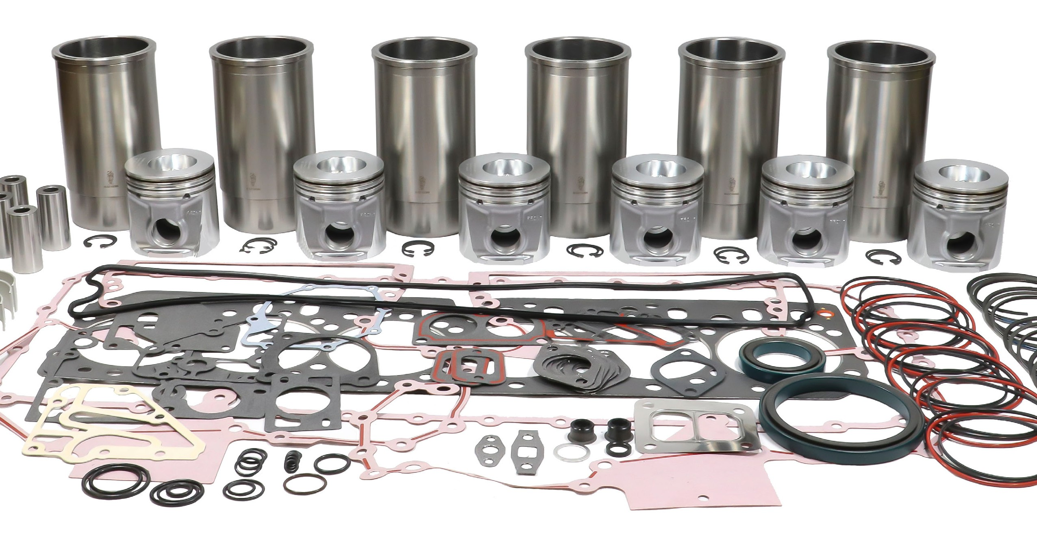
REPLACEMENT PARTS FOR
JOHN DEERE
®
Applications
REPLACEMENT ENGINE PARTS AVAILABLE FROM INTERSTATE-McBEE FOR
4045 / 6068 / 6090 APPLICATIONS:
ENGINE REBUILD KITS GASKET SETS
FUEL INJECTION AND MORE
® John Deere is a registered trademark of Deere & Company. All names, numbers, symbols, and descriptions are registered trademarks of Deere & Company and do not imply that the item/s are a product of said manufacturer.
June 2026 dee-foldout-6068

Slide 2

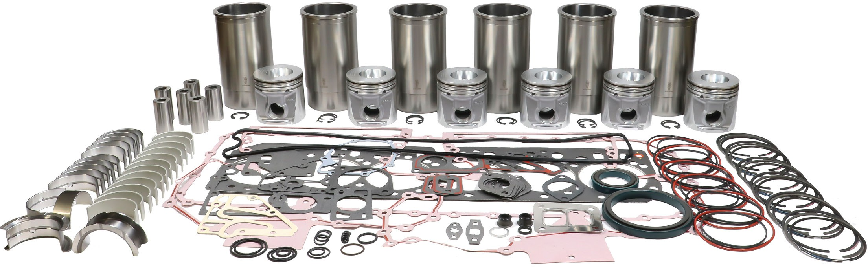
ENGINE REBUILD KITS
Interstate-McBee is offering new rebuild kits for John Deere® 4045, 6068, and 6090 Powertech diesel applications.
These high grade kits allow critical engine components to be replaced and are available as inframe or full overhaul kits.
Improving on previous offerings, the numbers listed cover up to Tier 4 engine models and are ideal for managing engine wear while minimizing downtime and labor expenses. A proper engine model and serial number verification is recommended to ensure compatibility.
CAST IRON
CYLINDER LINER
GRAPHITE COMPOSITE
HEAD GASKET
DIAMOND
TURNED PISTON
HARDENED AND TEMPERED
PISTON PINS
TRI-METAL BEARINGS
CAST
PISTON RINGS
OVERHAUL
COATED LINER
GASKET SET
SEALS
2
® John Deere is a registered trademark of Deere & Company. All names, numbers, symbols, and descriptions are registered trademarks
of Deere & Company and do not imply that the item/s are a product of said manufacturer.

Slide 3
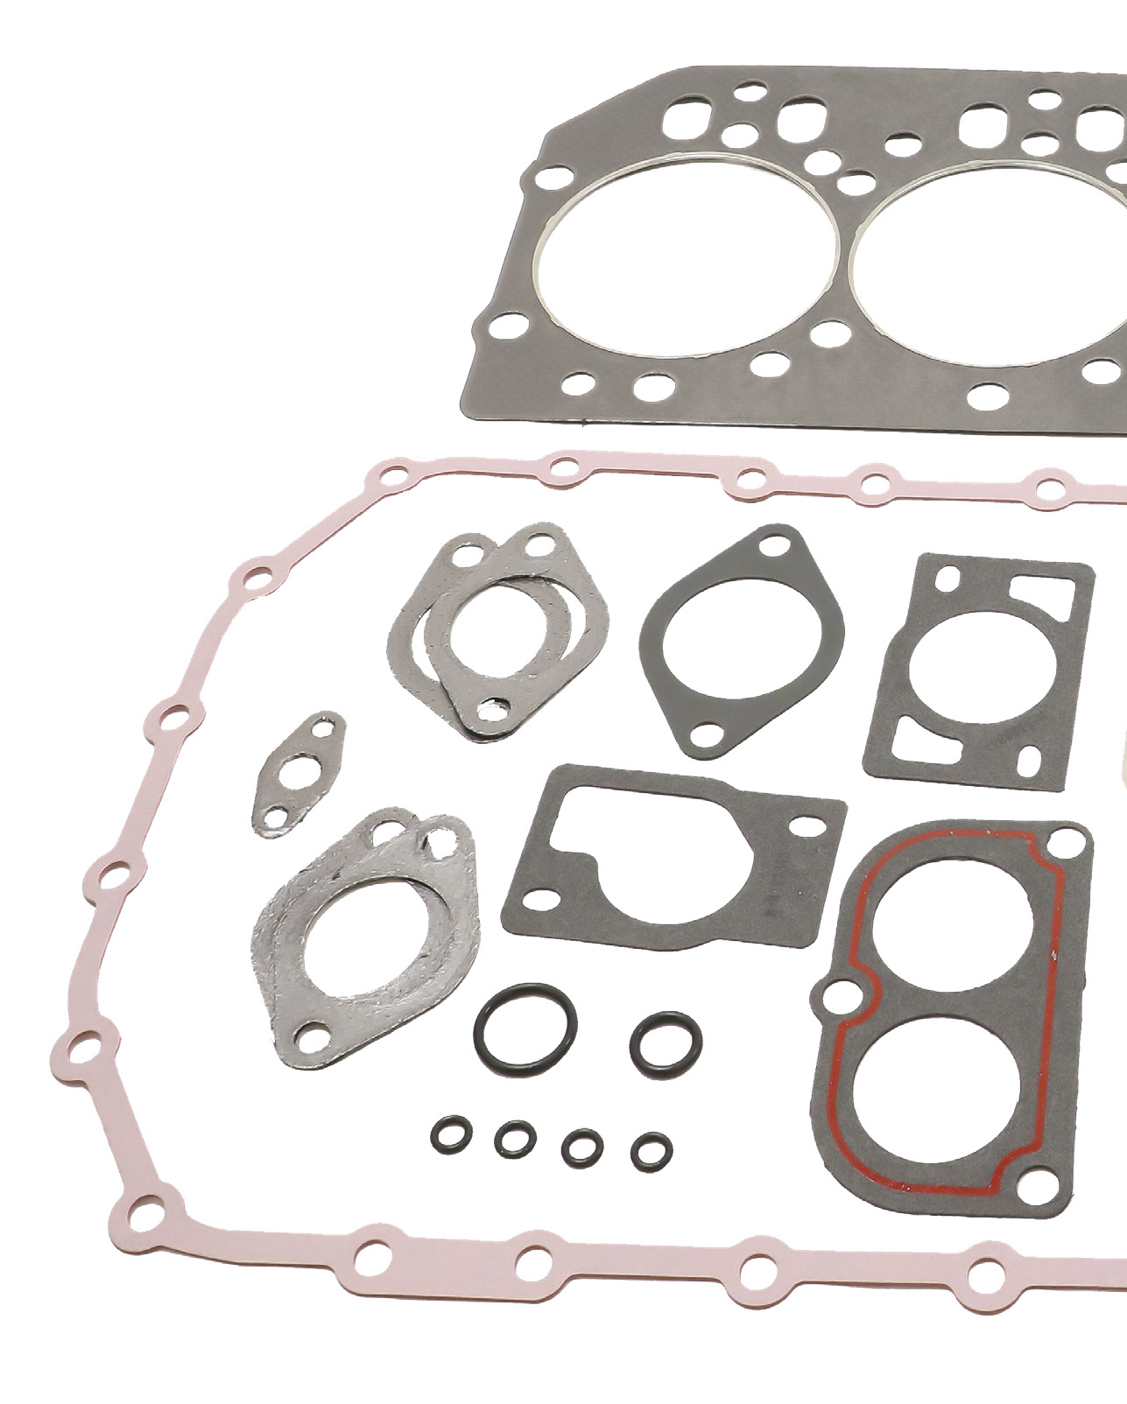


GASKET SETS
PART NUMBER | DESCRIPTION | APPLICATION | ENGINE DETAILS
M-RE536967 | Gasket Set - Cylinder Head | 4045 | T2, T3
M-RE536962 | Gasket Set - Overhaul | 4045 | T2, T3
M-RE527042 | Gasket Set - Overhaul | 4045 | T0, T1, T2
M-RE532713 | Gasket Set - Overhaul | 4045 | T0, T2, T3
M-RE526670 | Gasket Set - Cylinder Head | 4045 | T0, T1, T2
M-RE532842 | Gasket Set - Cylinder Head | 4045 | T0, T3, IT4
M-RE526671 | Gasket Set - Inframe | 4045 | T0, T1, T2
MCBRE527042OS | Gasket Set - Overhaul | 4045 | T0, T1, T2
M-RE527832 | Gasket Set - Inframe | 6068 | T2, T3
M-RE532631 | Gasket Set - Overhaul | 6068 | T2, T3
M-RE527833 | Gasket Set - Overhaul | 6068 | T0, T1, T3
M-RE526965 | Gasket Set - Overhaul | 6068 | T0, T1, T2
M-RE526672 | Gasket Set - Cylinder Head | 6068 | T0, T1, T2
M-RE532841 | Gasket Set - Cylinder Head | 6068 | T2, T3
M-RE526673 | Gasket Set - Inframe | 6068 | T0, T1, T2
MCBRE526965OS | Gasket Set - Overhaul | 6068 | T0, T1, T2
M-RE528400 | Gasket Set - Overhaul | 6090 | T0, T1, T3, IT4
M-RE528402 | Gasket Set - Cylinder Head | 6090 | T0, T1, T3, IT4
ENGINE KITS
PART NUMBER | DESCRIPTION | APPLICATION | ENGINE DETAILS
MCIFRE526971 | Kit - Inframe | 4045 | T0, T1,T2,T3
MCIFRE527298 | Kit - Inframe | 4045 | T0, T1,T2,T3
MCIFRE527299 | Kit - Inframe | 4045 | T0, T1,T2,T3
MCIFRE532715 | Kit - Inframe | 4045 | T2, T3
M-RE527299 | Kit - Overhaul | 4045 | T0, T1, T2
M-RE527298 | Kit - Overhaul | 4045 | T0, T1, T2
M-RE526971 | Kit - Overhaul | 4045 | T0, T1, T2
M-RE532715 | Kit - Overhaul | 4045 | T2, T3
MCIFRE526966 | Kit - Inframe | 6068 | T2, T3
MCIFRE527300 | Kit - Inframe | 6068 | T0, T1,T2
MCIFRE527301 | Kit - Inframe | 6068 | T4
MCIFRE540226 | Kit - Inframe | 6068 | T2, T3
M-RE526966 | Kit - Overhaul | 6068 | T0, T1, T2
M-RE527301 | Kit - Overhaul | 6068 | T0, T1, T2
M-RE540226 | Kit - Overhaul | 6068 | T0, T1, T2
MCIFDZ10599 | Kit - Inframe | 6090 | T2, T3
M-DZ10599 | Kit - Overhaul | 6090 | T2, T3, IT4, T4
WANT TO SEE OUR KITS IN REAL TIME?
Scan below for an unboxing of a Replacement InFrame Kit for John Deere® 6068 Power Tower Train Engines.
® John Deere is a registered trademark of Deere & Company. All names, numbers, symbols, and descriptions are registered trademarks
3
of Deere & Company and do not imply that the item/s are a product of said manufacturer.

Slide 4

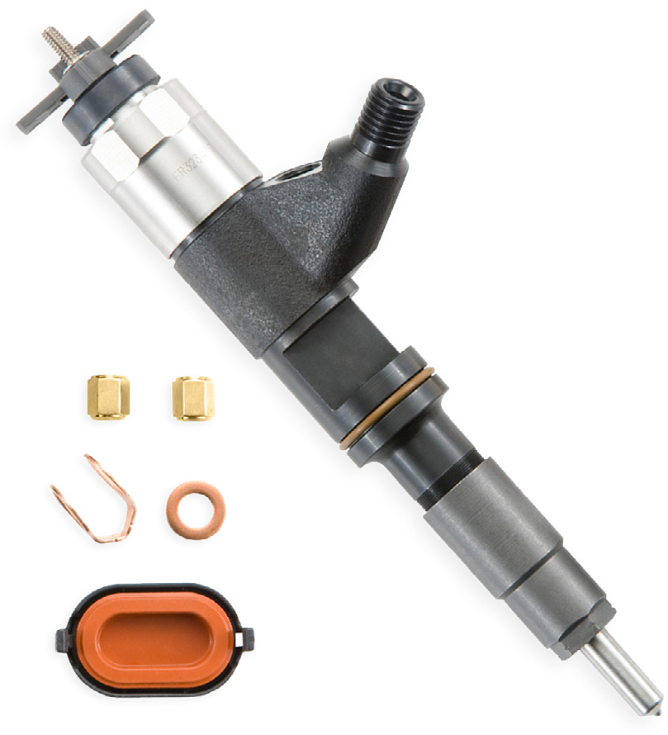

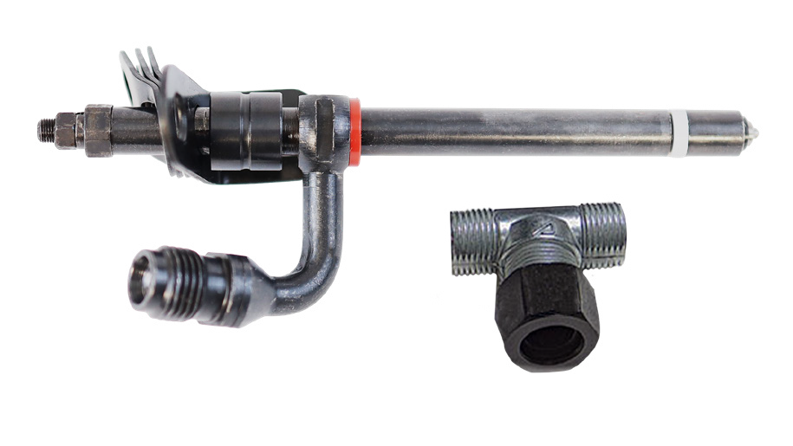




FUEL INJECTION
4045/6068 REMAN INJECTORS
PART NUMBER | APPLICATION | DESCRIPTION
R-DZ100212 | 4045 (4.5L) / 6068 (6.8 L) | Reman Injector + Nozzle Kit
R-DZ100216 | 4045 (4.5L) / 6068 (6.8 L) | Reman Injector + Nozzle Kit
R-DZ100217 | 4045 (4.5L) / 6068 (6.8 L) | Reman Injector + Nozzle Kit
R-RE545562 | 4045 (4.5L) / 6068 (6.8 L) | Reman Injector + Nozzle Kit
Scan here for the full John Deere® Reman Injector flyer, including pictures and cross reference numbers.
PENCIL NOZZLE
PART NUMBER | APPLICATION | DESCRIPTION
M-28485 | General Use | Pencil Nozzle
All of these parts go through an extensive qualification process and are covered by our industry leading warranty. Interstate-McBee is proud to be ISO 9001:2015 Certified with Design.
Distributor Name / 00000 Street Name / City Name, State 00000
000-000-0000 / www.companywebsite.com

