Slide 1

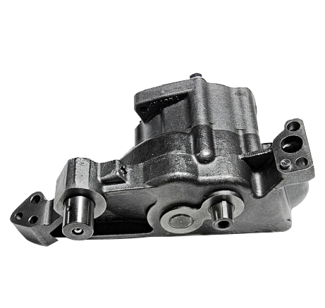
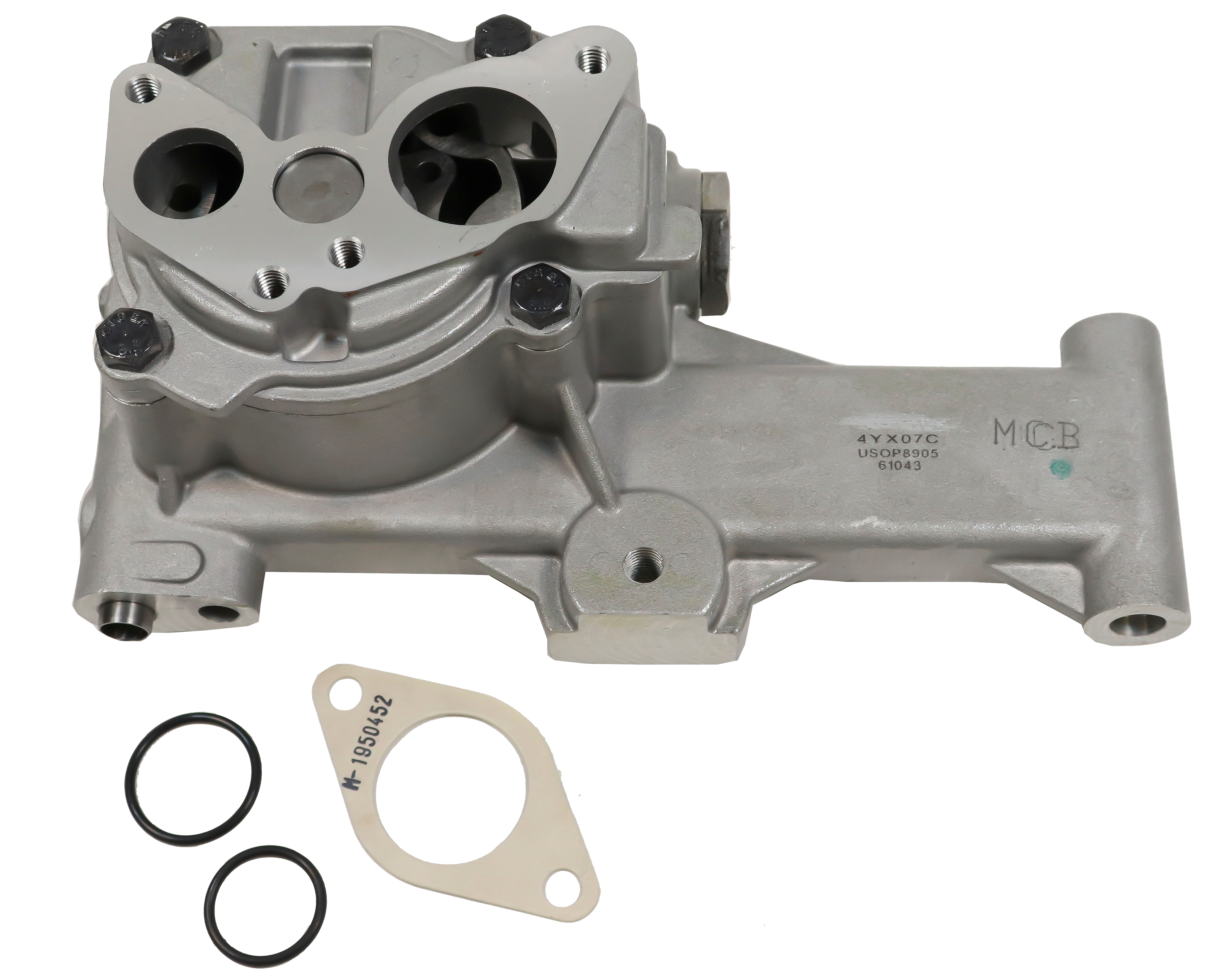
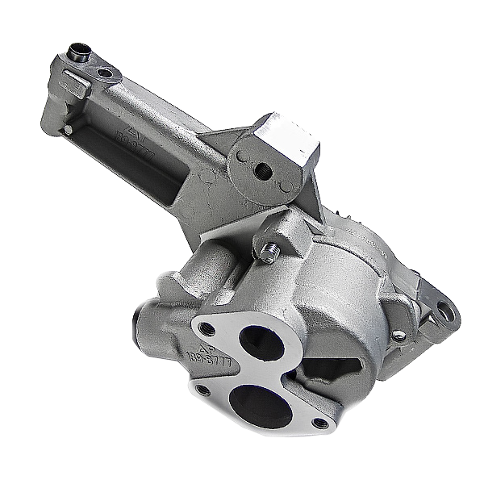
REPLACEMENT
OIL PUMPS
AVAILABLE FOR THE FOLLOWING APPLICATIONS
Caterpillar®
3116 | G3304 / G3306 / G3408 / G3412 | 3406E | 3126 | C7 | C12 | C13
Cummins®
ISX | QSX | N14 | ISB | QSB | ISC | QSC | ISL | QSL | QSK | M11 | KT / QSK
Detroit Diesel®
Series 60 | DD15
Navistar®
DT466 | DT466E
Pictured Clockwise from Top: M-3318905, M-6I1346, M-1898777
®All manufacturers’ names, numbers, symbols and descriptions are registered trademarks of that respective corporation or entity and do not imply that the item(s) are a product of said manufacturer.

Slide 2
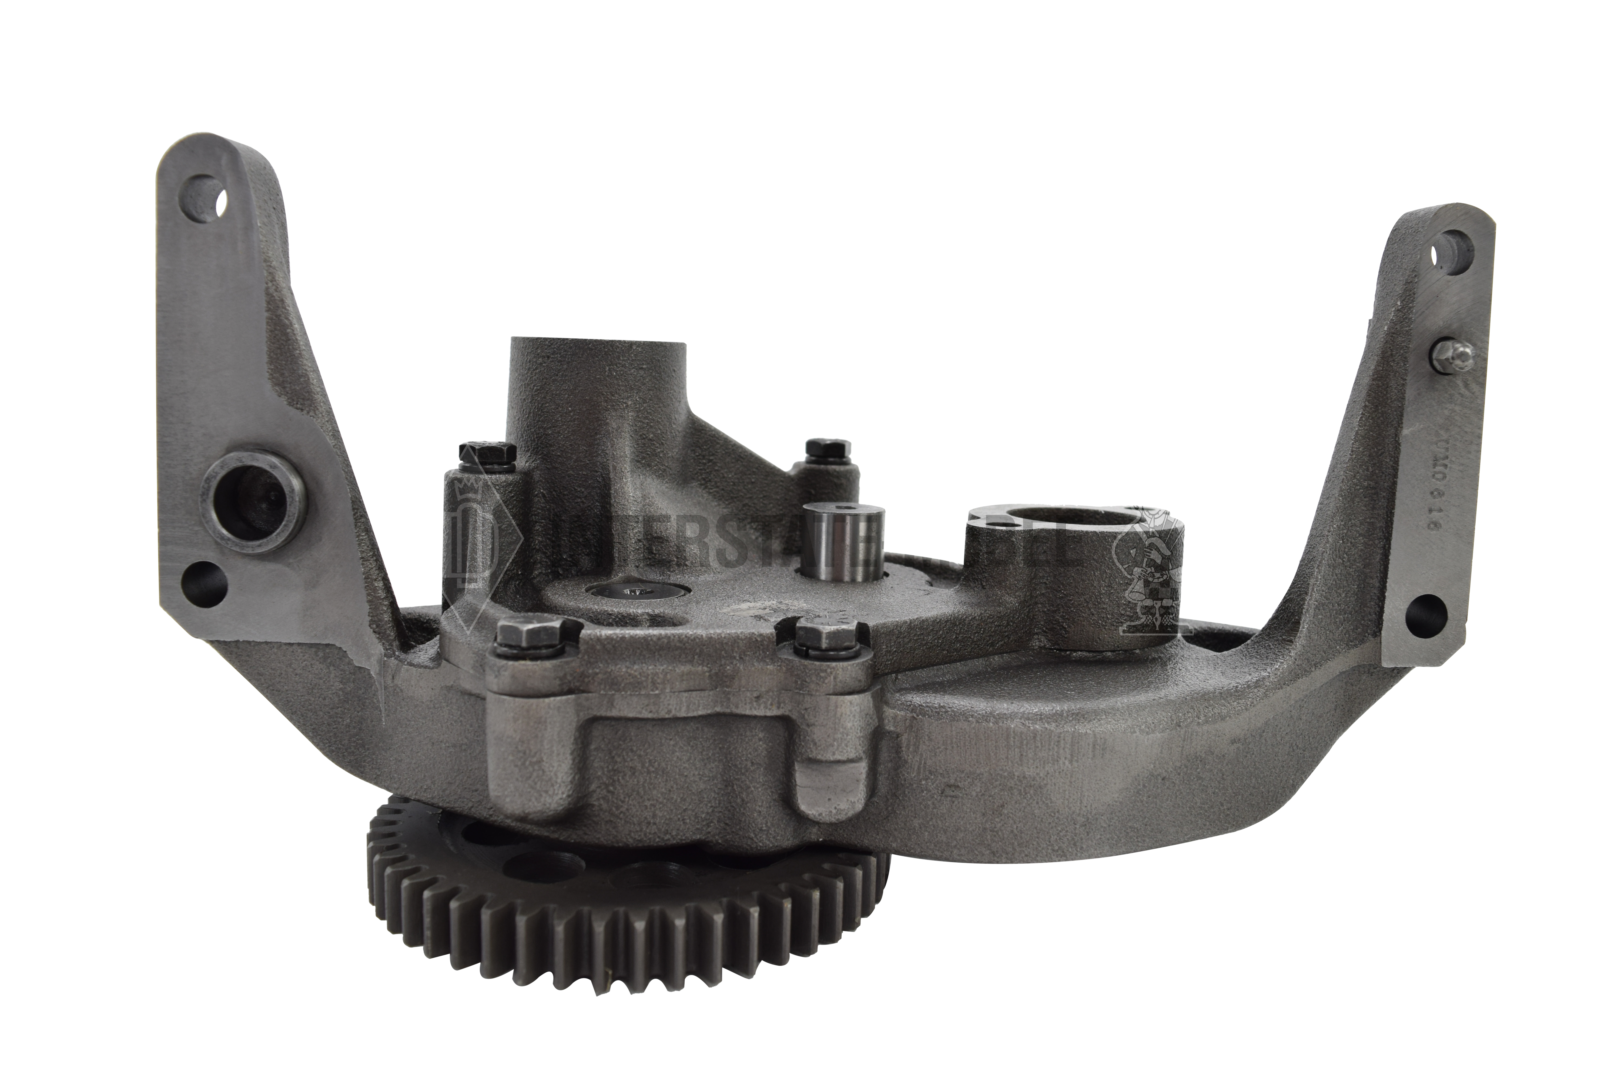
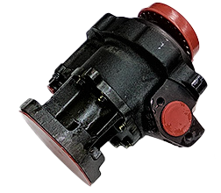
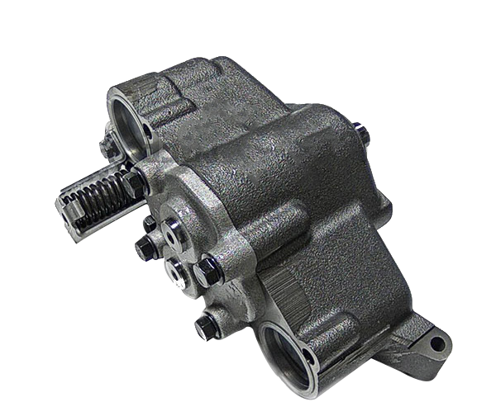
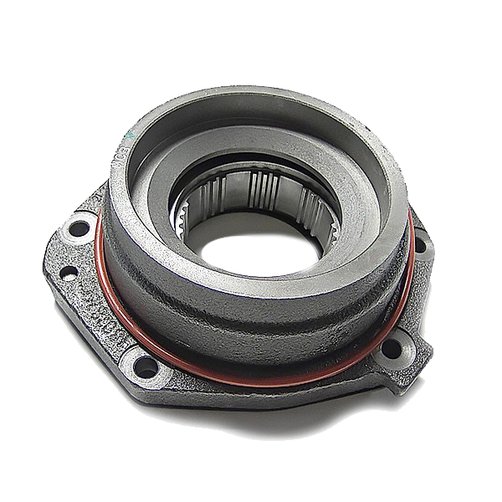


OEM | PART # | APPLICATION(S) |  | OEM | PART # | APPLICATION(S)
Cummins | M-3042378 | NT/NTA 855 |  | Caterpillar | M-6N1030 | G3412
Cummins | M-3803369 | N14 |  | Caterpillar | M-6I1343 | G3304/G3306
Cummins | M-3803698 | N14 |  | Caterpillar | M-6I1346 | G3304/G3306
Cummins | M-3821572 | 855 |  | Caterpillar | M-1614113 | 3406E/C15/G3408
Cummins | M-3930337 | 4BT/6BT |  | Caterpillar | M-4N733 | 3406/3406E/G3406
Cummins | M-4897481 | B/ISB/QSB |  | Caterpillar | M-1898777 | 3114/3116/3126/C7
Cummins | M-4939585 | 4B |  | Caterpillar | M-2004497 | 3116/3126/C7
Cummins | M-4939586 | 4BT/6BT |  | Caterpillar | M-2231608 | C13
Cummins | M-4939587 | 6B |  | Caterpillar | M-2335220 | C12
Cummins | M-4939588 | 6B
 |  |  |  | Detroit Diesel | A-23505886 | S60
Cummins | M-4988801 | 6B
 |  |  |  | Detroit Diesel | A-23527448 | S60
Cummins | M-3800828 | 6CT
 |  |  |  | Detroit Diesel | A-A4721803101 | DD15
Cummins | M-3948072 | ISC/QSC
 |  |  |  | Detroit Diesel | A-A4721803901 | DD15
Cummins | M-3966840 | 6CTA
 |  |  |  | Navistar | M-1802666C92 | DT466/DT466E
Cummins | M-4983588 | ISL/QSL
 |  |  |  | Navistar | M-1808832C92 | DT466/DT466E
Cummins | M-3634640 | KTA38/QSK38
 |  |  |  | Navistar | M-1822326C91 | DT466/DT466E
Cummins | M-4003950 | M11/ISM
 |  |  |  | Navistar | M-1881751C93 | DT466/DT466E
Cummins | M-4309499 | ISX/ISX15/QSX
Cummins | M-5532492 | ISX/ISX15/QSX
M-3803369
A-23527448
M-6N1030
M-1808832C92
Distributor Name / 00000 Street Name / City Name, State 00000
000-000-0000 / www.companywebsite.com
SERVING THE OIL AND NATURAL GAS INDUSTRIES FOR OVER 75 YEARS

